Slide 1
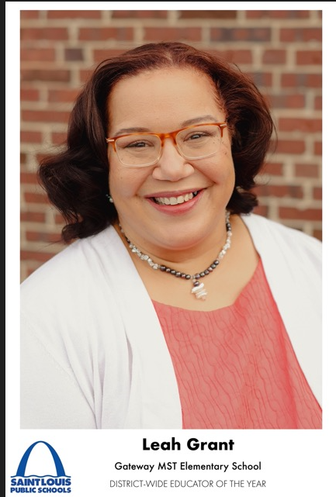
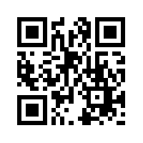
Hello! Welcome to a wonderful and engaging school year. We will delve into a standards-based curriculum with peace, joy and happiness.
I love reading books, making jewelry, nature, and enjoying my family time.
I would love for you to contribute to our classroom community of learners by viewing my classroom wishlist, and gifting an item to our classroom.
Greetings! My name is Mrs. Leah Grant, and I am thrilled to be a third grade teacher. I’ve had the pleasure of teaching at Gateway Elementary for the past 10 years. I am extremely excited about having your child in our learning community.

